Slide 1
Neural Network: Representation

Slide 2
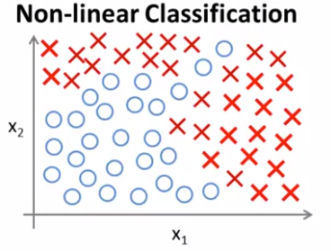

Non-linear Hypothesis
Non-linear Classification
$g(θ_{0}+θ_{1}x_{1}+θ_{2}x_{2})$

Slide 3
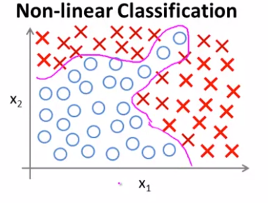
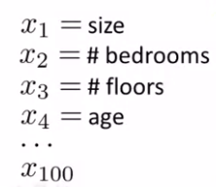

Non-linear Hypothesis
Non-linear Classification
$g(θ_{0}+θ_{1}x_{1}+θ_{2}x_{2}$
$+θ_{3}x_{1}^{2}+θ_{4}x_{2}^{2} + …)$
5000 quadratic features
160000 cubic features
……
Too many features

Slide 4

Non-linear Hypothesis
Non-linear Classification
Image Classification: Car or not Car?
300x300 color image => 270000 features

Slide 5
Neurons and the brain
Neural networks
Origin: Algorithms that try to mimic the brain
Widely used in 80s, popularity decreased in late 90s
Currently SOTA for many applications.

Slide 6
Neurons and the brain
Neural networks
Origin: Algorithms that try to mimic the brain
Widely used in 80s, popularity decreased in late 90s
Currently SOTA for many applications.

Slide 7
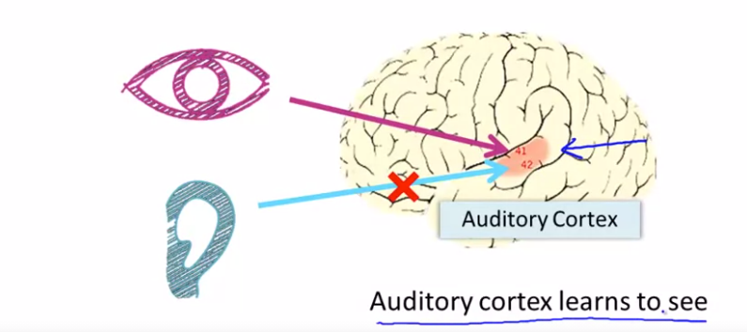
Neurons and the brain

Slide 8
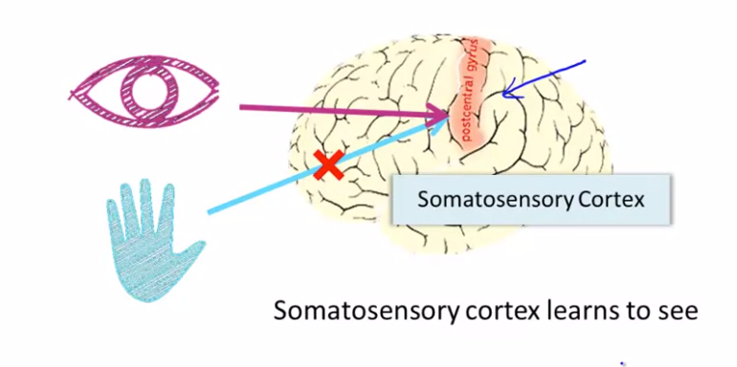
Neurons and the brain

Slide 9
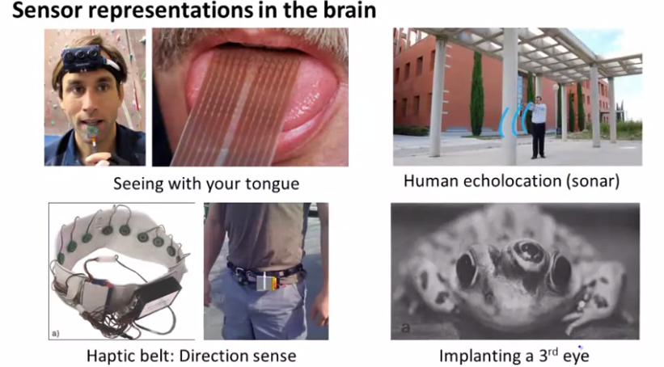
Neurons and the brain

Slide 10
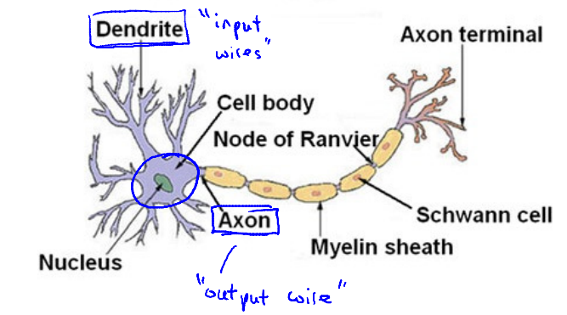
Neural in the brain
At a very simple level, neurons are basically computational units that take input (dendrites) as electrical input (called "spikes") that are channeled to outputs (axons).

Slide 11
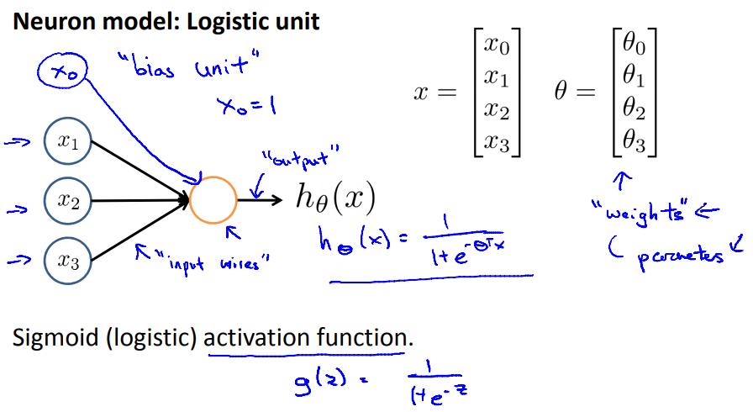
Neural model: Logistic unit

Slide 12
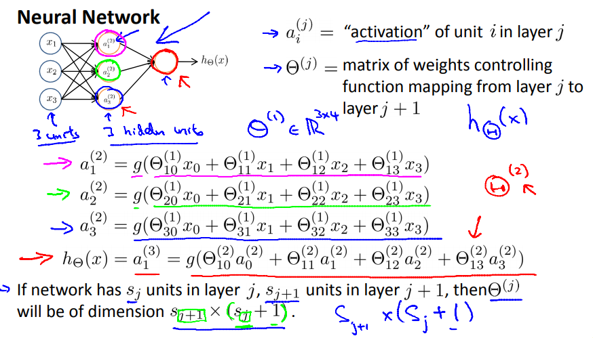
Neural network

Slide 13
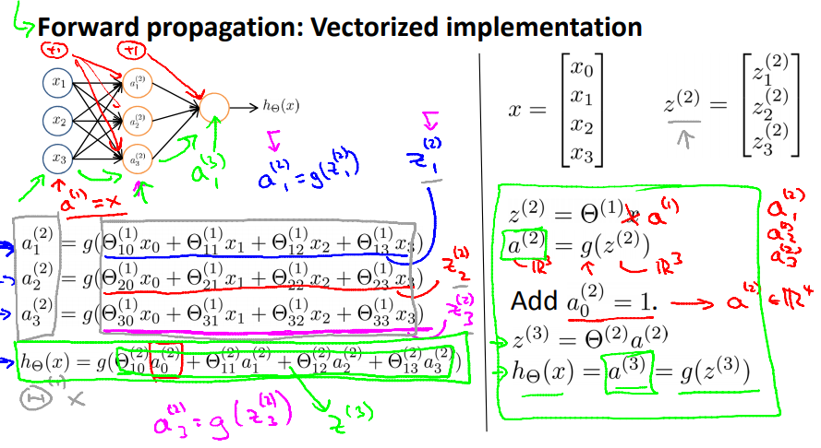
Model presentation II: Forward propagation

Slide 14
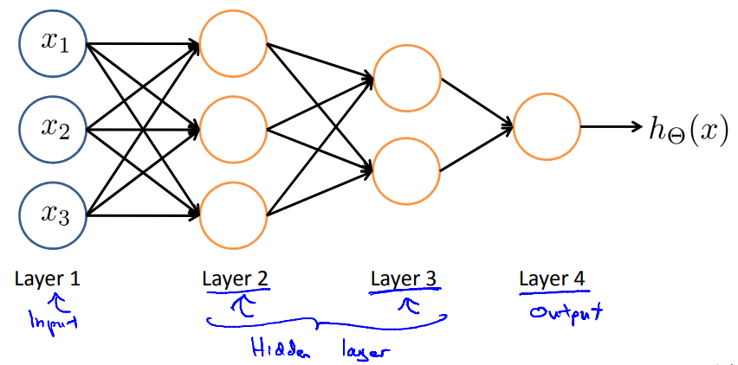
Other network architectures

Slide 15
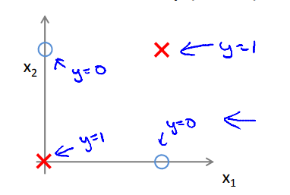
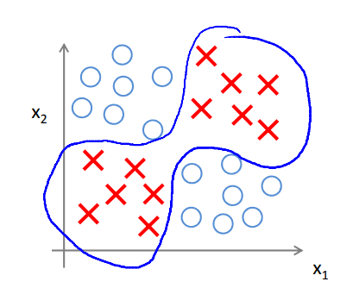
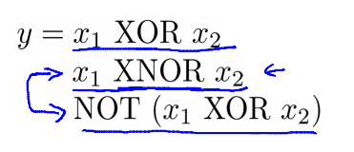
Non- linear classification example: XOR/ XNOR
$x_{1}, x_{2}$ are binary (0 or 1)

Slide 16
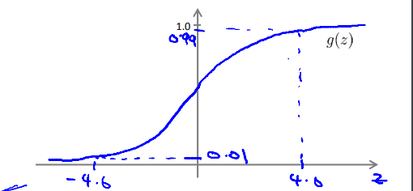
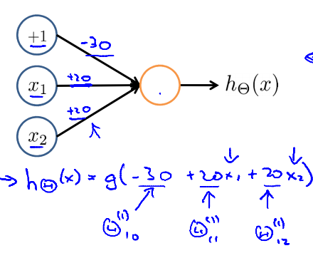
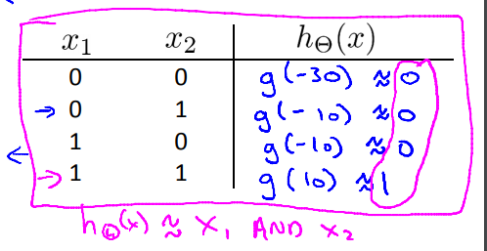
Simple example: AND
$x_{1}, x_{2}$ Є (0 or 1)
y = $x_{1} AND x_{2}$

Slide 17
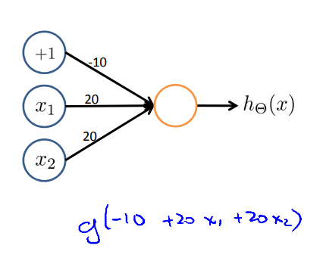
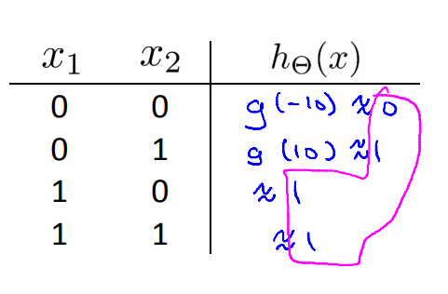
Example: OR

Slide 18
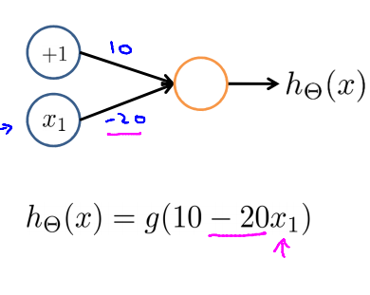
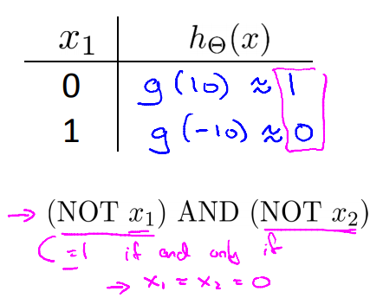
Negation
NOT $x_{1}$

Slide 19
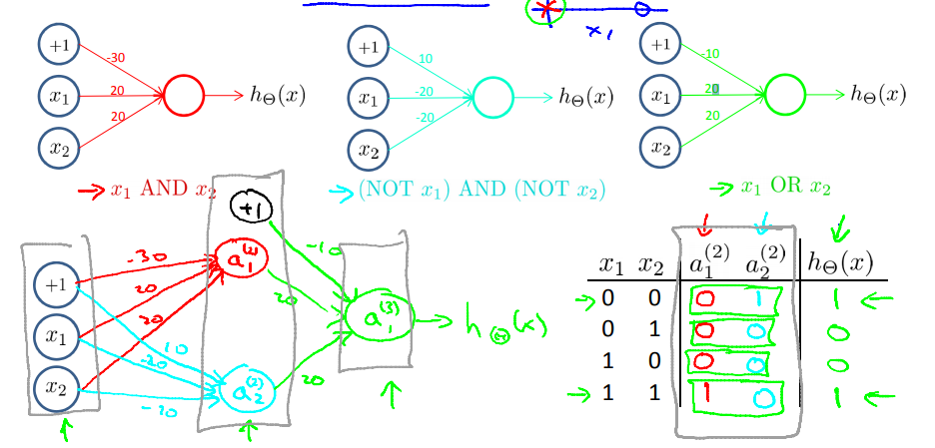
Putting it together
$$x_{1} XNOR x_{2}$$

Slide 20
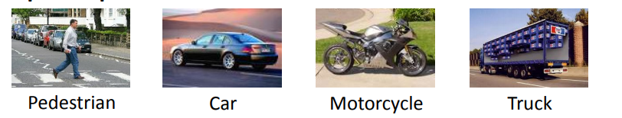
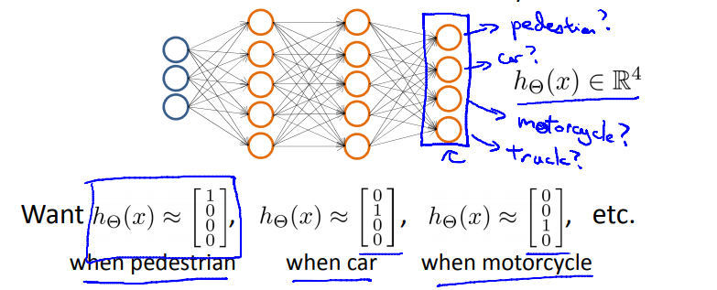
Multi – class classification

Slide 21
